Slide 1
Congregational federation Christmas 2020 ideas

Slide 2
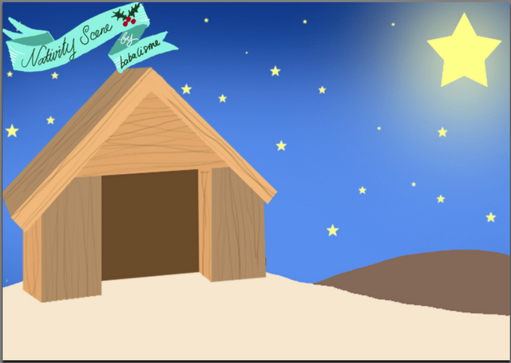
Making the most of the a Covid Christmas
Christmas is not cancelled
We need to think beyond ‘Carols’
Sharing the Good news with families
Sharing the Good news by caring for people
Sharing the Good new in our building
Sharing the Good news without a building
Making the most of Advent

Slide 3
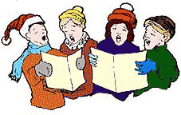
Christmas is not Cancelled
Get out of sticking plaster mode
Take the opportunity to mix things up
Think beyond the 25th December
Gather a team
Risk Assess

Slide 4
Thinking beyond Carols
2018 YouGov poll said 49% of people said the idea of going to church at Christmas was irrelevant to them
Listening/Singing carols was liked by 61% people
Gathering together for Christmas dinner is likely to be restricted
Local travel restrictions
8 million people live alone
650,000 fewer people on the national payroll
It might be helpful to think about these 3 overlapping groups
Church Family
Community
Children

Slide 5
Good news for families with children
Don’t want
More livestreams or screen options
Want their children’s behaviour to be on show
Want a sad version of last year
Do want
an immersive experience offering wonder
Enjoy adventure and informality
Want to be part of their community
Want to create memories

Slide 6
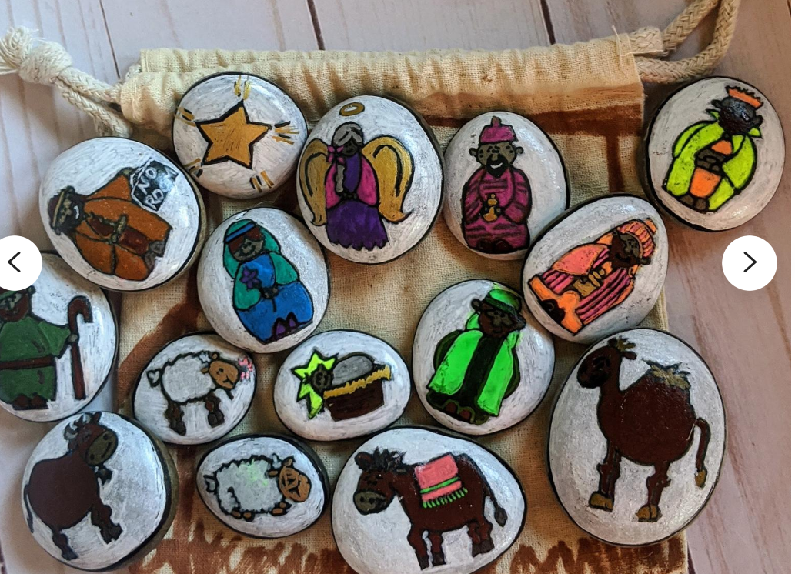
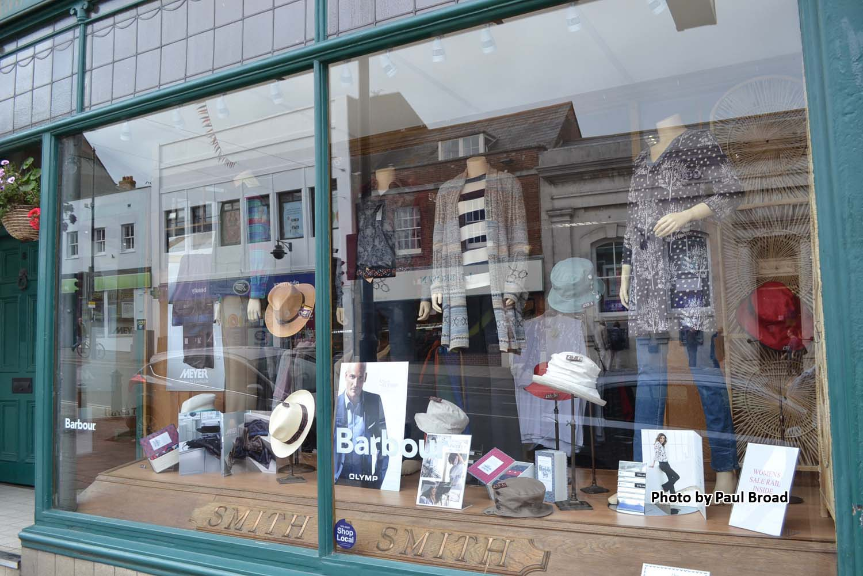
Deconstructed Nativity
Treasure Hunt – nativity figures in shop windows
Hunt the Stranger?
Household tableaux
Treasure Hunt
or
Geocaching – swaps

Slide 7
Christmas- easy recipes
Recipe to be sent to the families
Recipe and ingredients (deprived families)
The recipe can be done over Zoom- Really good fun for families and kids

Slide 8
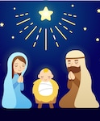
Good news by caring for people - something free to people who have no concept of grace
Good neighbours
Offering hospitality
Christmas cards

Slide 9
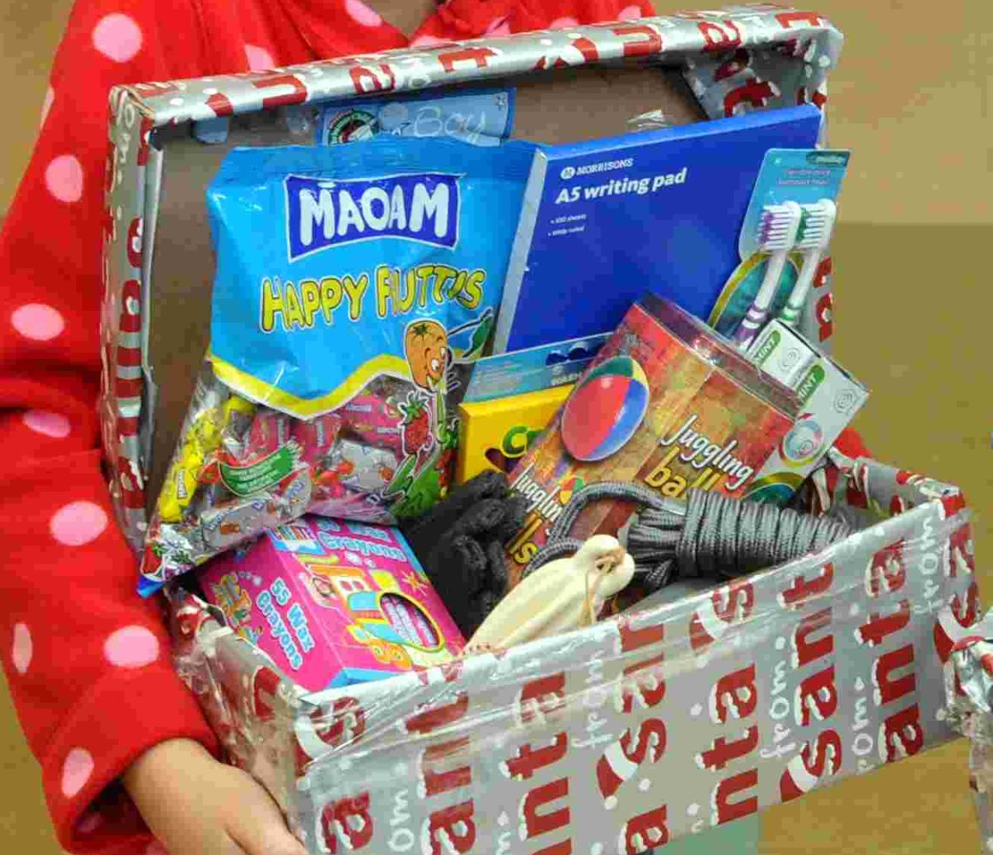
Shoes box appeal style – list given to the member
List + (box) = members
Members to drop it back to the church
to be delivered to isolated person or families
If some people don’t want to participate they can
be encouraged to donate money towards the boxes
to bless others

Slide 10
Christmas in a Box- meal – isolated people
?
Small Gift
Christmas Dinner
A DeMince Pie
Christmas Cake
coration
A Christmas “Tract”
Deconstructed Cracker

Slide 11
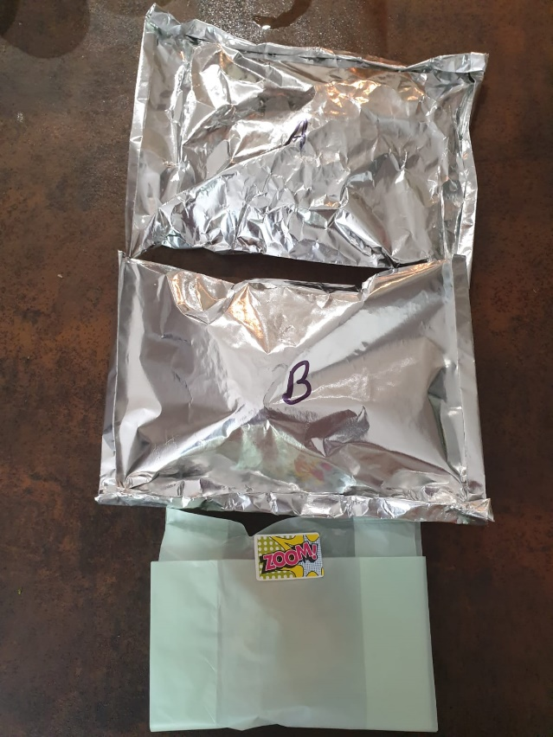
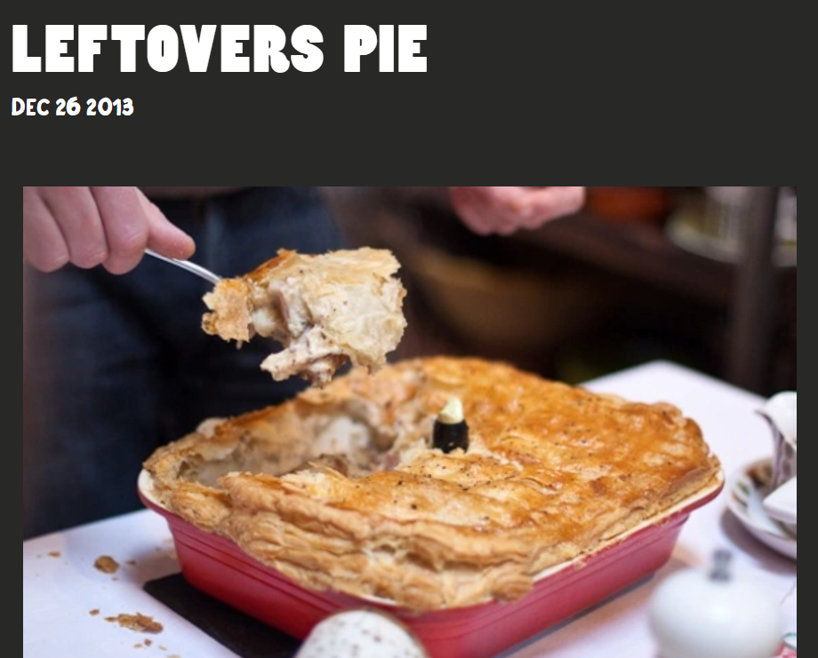
Christmas Dinner Delivery Ideas…
Foil bags
A: Steam turkey in gravy
B: Steam veg
Pieminister Pies

Slide 12
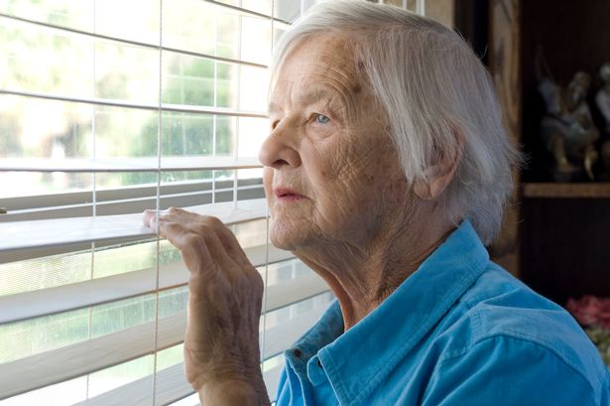
Connecting Church Family- intergenerational act
Safeguarding and the pastoral team to
advice on this.
Encourage intergenerational interaction
Adopt an elderly
An elderly isn't just for Christmas
Cards
Decorated Biscuits
Prayers
Gifts
Mince Pie or Christmas Cake

Slide 13
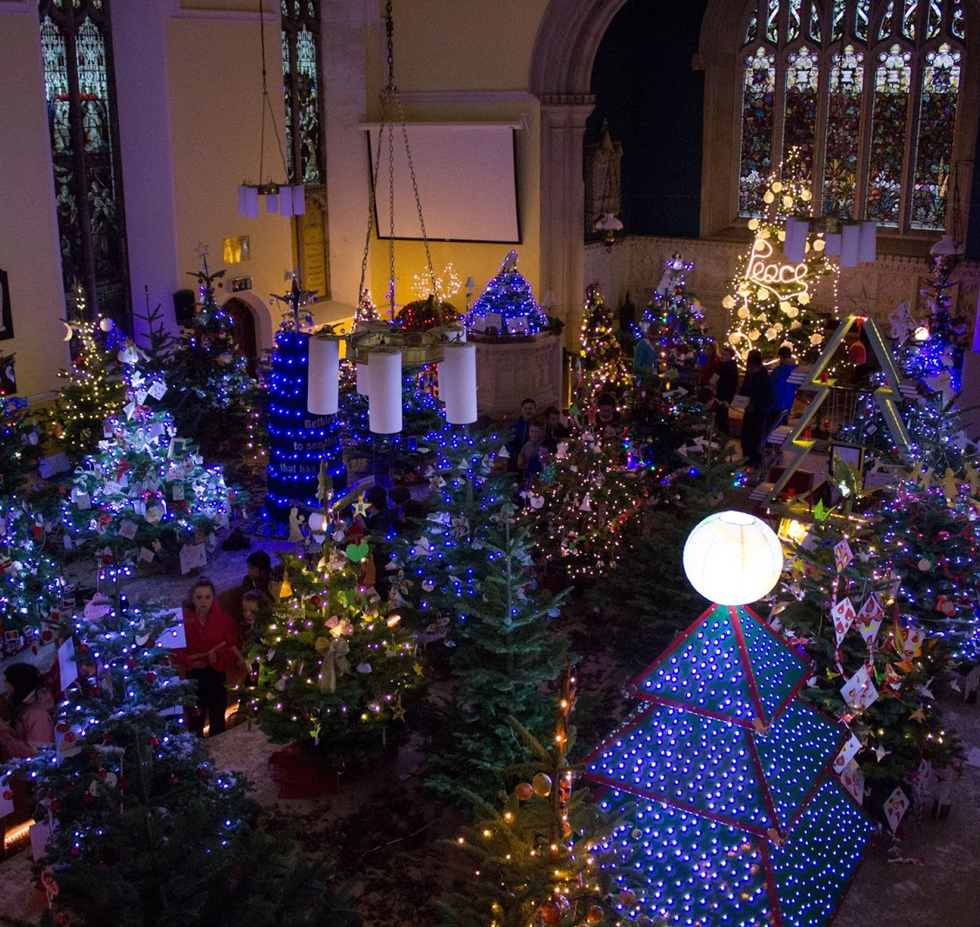
Good news in our buildings
Socially distanced events
Traditional nativity
Instant Nativity
Chocolate nativity
Christingle
Walk through events
Stable trail
Christmas tree festival
Sanctuary of peace and quiet
Outside the Building
Projection screen

Slide 14
Christingle
Can be prepared 72 hours in advance
Bags can be prepared with all the parts in
Order free Christingle at home bags
Lots of resources for ideas on www.childrenssociety.org.uk

Slide 15
Instant Nativity – Bible Society
Looking for a fun and interactive, rehearsal-free Christmas nativity play to perform in your church? Look no further!
Adapted by Bob Hartman from the children’s booklet, this energetic nativity script will be enjoyed by all ages at a Christmas service. Download the PowerPoint that follows along with the script for background images.
We’ve also created an online-friendly version, so even if you can’t be together in person at church people can still dress up in costumes as nativity characters and perform the script together online.

Slide 16
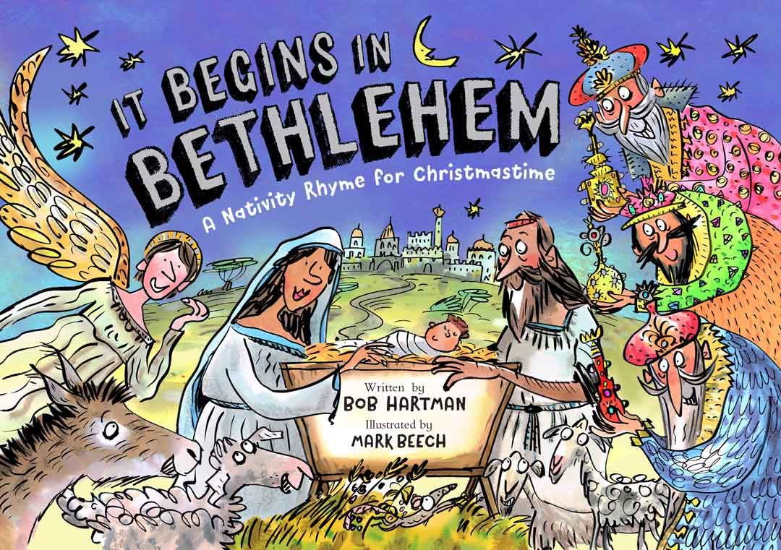
Bible Society Books
Our new Christmas children’s booklet It Begins in Bethlehem – A Nativity Rhyme for Christmastime gives us a fresh perspective on the nativity with glorious rhymes from Bob Hartman and lively illustrations by Mark Beech. Discover God’s Christmas present to you! Brilliant to share the message of Christmas with children in your family, church and community.
https://youtu.be/D06k9vulAVQ

Slide 17
Chocolate Nativity
This is a script for a Chocolate Nativity – to add a fun element to it you can hand out the bars of chocolate as you go along.
A long time ago, God made the Galaxy – Beautiful,rich, wonderful
And he filled it with people, people he loved, people like you and me, people who were all special to him. And he gave these people everything.
Everything except one tree, one Fruit Past-all others which they were told not to eat.
But the people wanted to do things their own way. They decided to Breakaway from God. Trouble is, everything started to go wrong! Things got really really Rocky.
Suffering, pain, loneliness, bullying, violence, death – because we’d chosen our way instead of God’s way.
Everything got really Haribo (horrible)
So to give them a Boost God promised that things would change. One day a special person would come and put things right
Many years later, a young woman was FRIGHTENED OUT OF HER WITS when an angel suddenly turned up. The Angel wondered if he might ease her fear.
Don’t be scared he said, You’re going to have a son, the Son of God, call him Jesus
A name that means he’ll save people, he’ll make them friends with God again.
And though Joseph was a bit confused, he was a good egg,you couldn’t hope to meet aKinder man,so he decided to look after Mary, and God’s baby.
So as the story goes Mary and Joseph traveled to Bethlehem. The journey was nopicnic and with Mary heavily pregnant, Joseph wondered if she’d Flake out on the way.
From Nazareth to Bethlehem – they might have even passed Jaffa on the way. They finally found a room full of animals – it might not have been a stable,
sometimes people lived in a house with a split floor, animals on one level, people on the next, so maybe the innkeeper let them into his home.
We don’t know what sort of animals there were, sheep, donkeys, cattle – maybe even a KitKat, but by morning there was Jesus nestling in his mother’s arms.
All sorts of strange visitors started to turn up.
First some shepherds: they’d been up on the hillside, looking up at the Milky Way
When some angels appeared in the sky and said go and see God’s promised saviour
Tell everyone, don’t Wispa, shout it out, God is here.
So straight as an Aero they headed for Bethlehem to find Jesus.
Further away, some wise men were looking up at the planets in the sky: Saturn, Jupiter,Mars, when they saw something amazing. They saw the most amazing Star-bar all others!
So the kings packed up their bounty – presents for the new king
And came to see Jesus. They didn’t find him at king Herods palace,
But those wise men were Smarties,they didn’t give up
And when they found Jesus they brought out their gifts, no Twix, just gifts:
Gold for a king, incense for worship, myrrh for death.
And here’s the Crunch (ie)
Jesus, the baby was the Son of God, sent by God into the world.
And if that story doesn’t make you smile – then Bah Humbug!
This Photo by Unknown Author is licensed under CC BY-NC-ND

Slide 18
New ideas
Happyland Nativity video 3 mins: https://gochattervideos.com/happyland-nativity/
Can be used in a messy Christmas or nativity service
Mentimeter.(Speedy Quiz)! Excellent for kids. It’s an interactive platform in which you can involve the people who are watching in the session by asking biblical questions and general knowledge questions making the participants compete against each other. It times how quick and accurate each person or team answers and it tallies the result instantaneously so it is fast and snappy perfect for kids. https://www.mentimeter.com/
Pictionary scripture game … (Christingles) or messy church.
Example: draw an angel, a pregnant woman, a message, saviour, Gods son, holy spirit etc…
Ask the teams: Which verse in the Bible are these pictures connected to?

Slide 19
Alternative Carol Service
The carol service is premiering on TBN on 2nd December, and the full download will be available from Monday 7th December for you to use in the way most helpful for your congregation. Just let me know and I’ll get a copy emailed to you once it’s available.
It’s an hour-long programme packed with musical performances from Compassion ambassadors: Philippa Hanna, Noel Robinson, Graham Kendrick, and their friends, Hillsong London, Bazil Meade & the London Community Gospel Choir, Lurine Cato, Martin Smith, Elle Limebear, as well as songs and Bible readings from around the world.

Slide 20
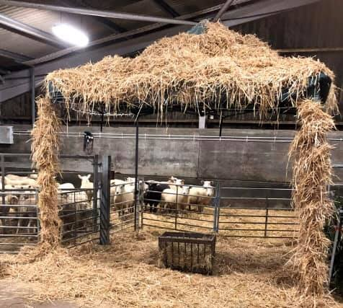
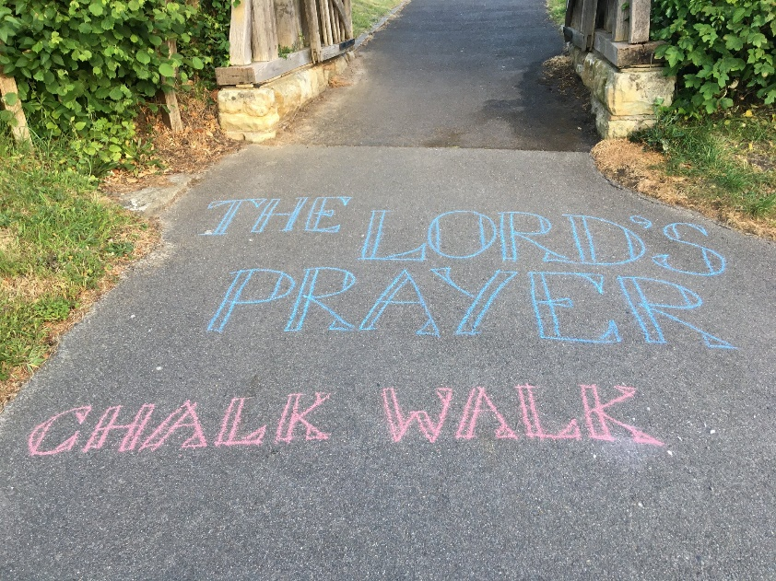
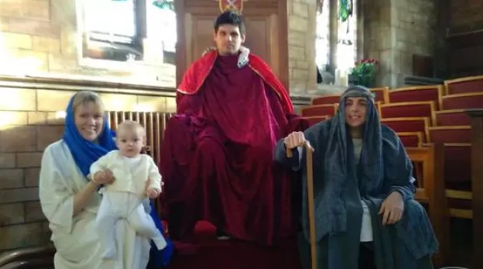
Walk Through Events

Slide 21
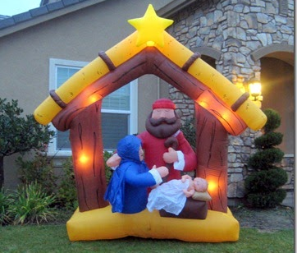
Inflatables and Lights

Slide 22
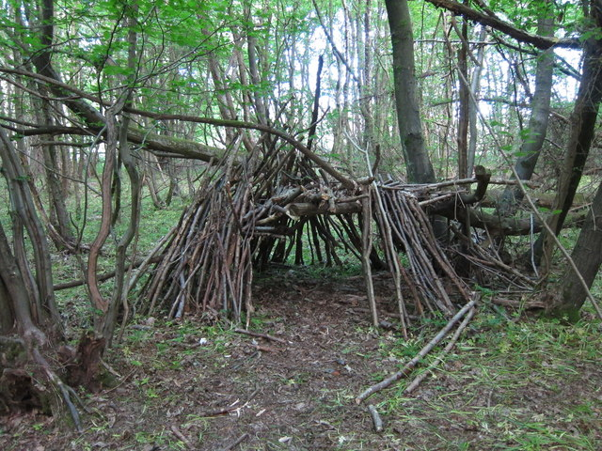
Good news without a building
Drive through
Forest church
Carnival
Messy Nativity trail

Slide 23
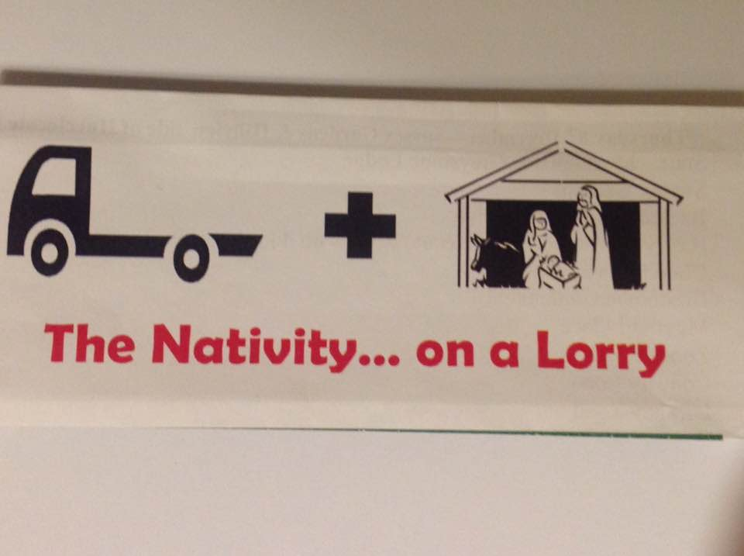
Take the Nativity to them
https://www.facebook.com/chingfordcong/videos/918884421897599/?t=56
Dave Simms in South Chingford

Slide 24
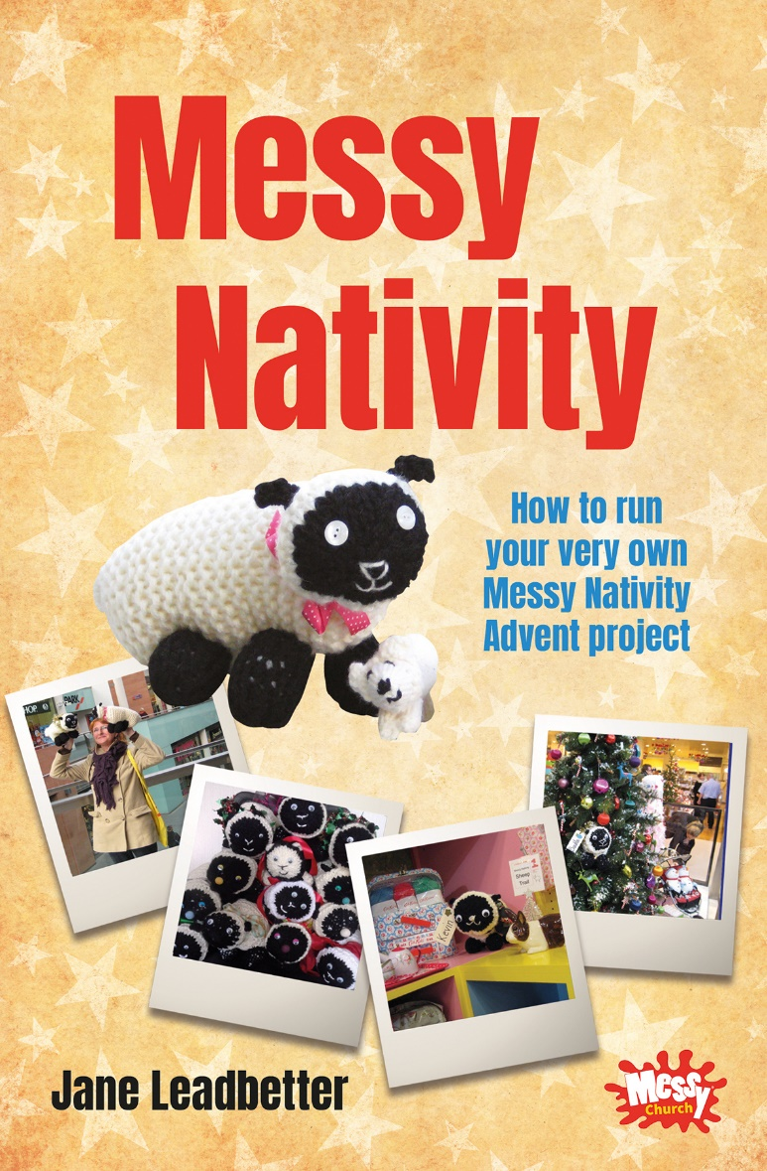
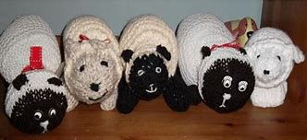
Messy Nativity
Church knit sheet
Church make links in the community with local shops and businesses
Families search for the sheep
Competition
Message of Jesus

Slide 25
Making the most of Advent
Screen projections
Church member windows

Slide 26
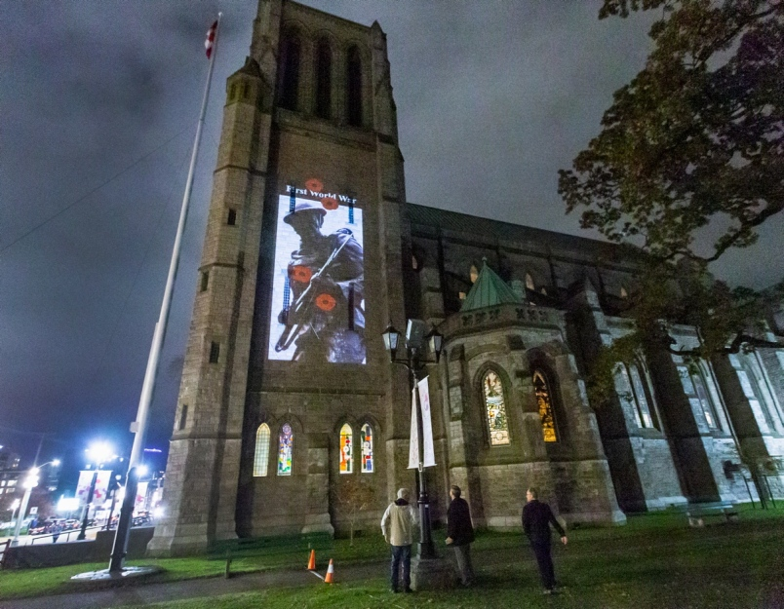
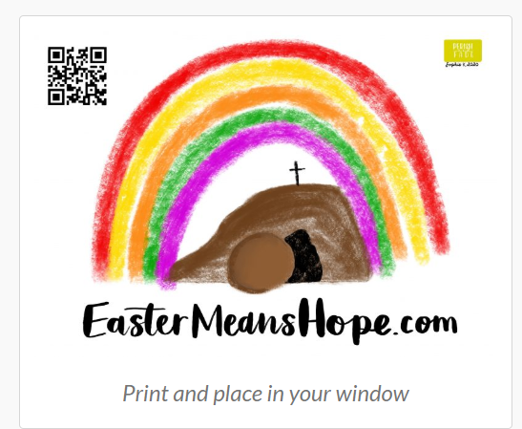
Advent Calendar on the Church Building
Use your house window
https://www.10ofthose.com/uk/products/24485/names-of-jesus-advent-calendar

Slide 27
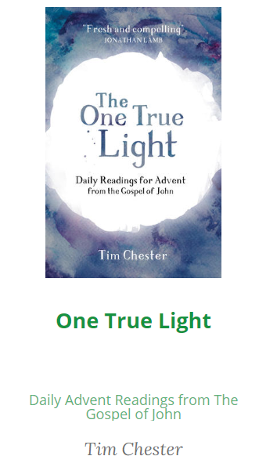
Shared Advent Readings

Slide 28
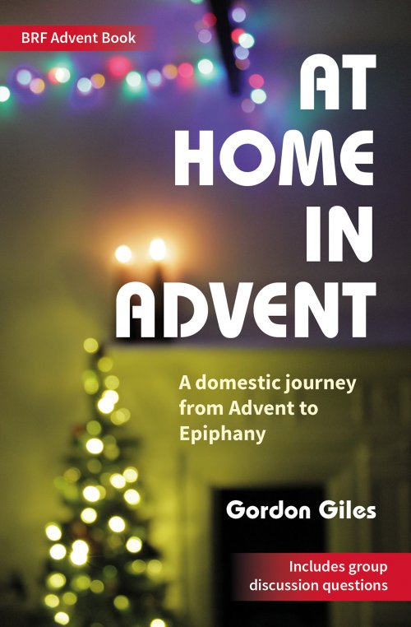
Advent at Home

Slide 29
Resources
CPO - https://www.cpo.org.uk/catalogue.aspx?cat=5010
Posters
Cards
Books
10ofthose.com https://www.10ofthose.com/uk/special-offers/point-to-jesus-this-christmas
Tracts
Books
Cards
www.theresourcehub.co.uk

