Slide 1
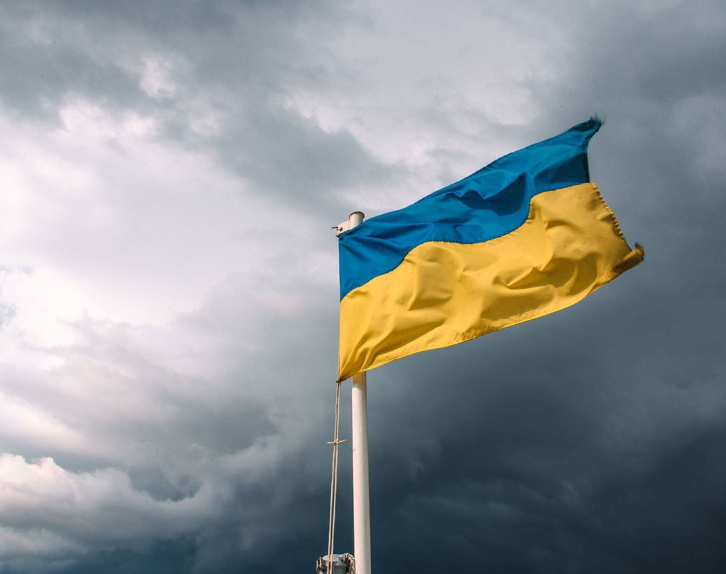
I can
By John Roedel

Slide 2
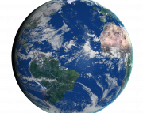
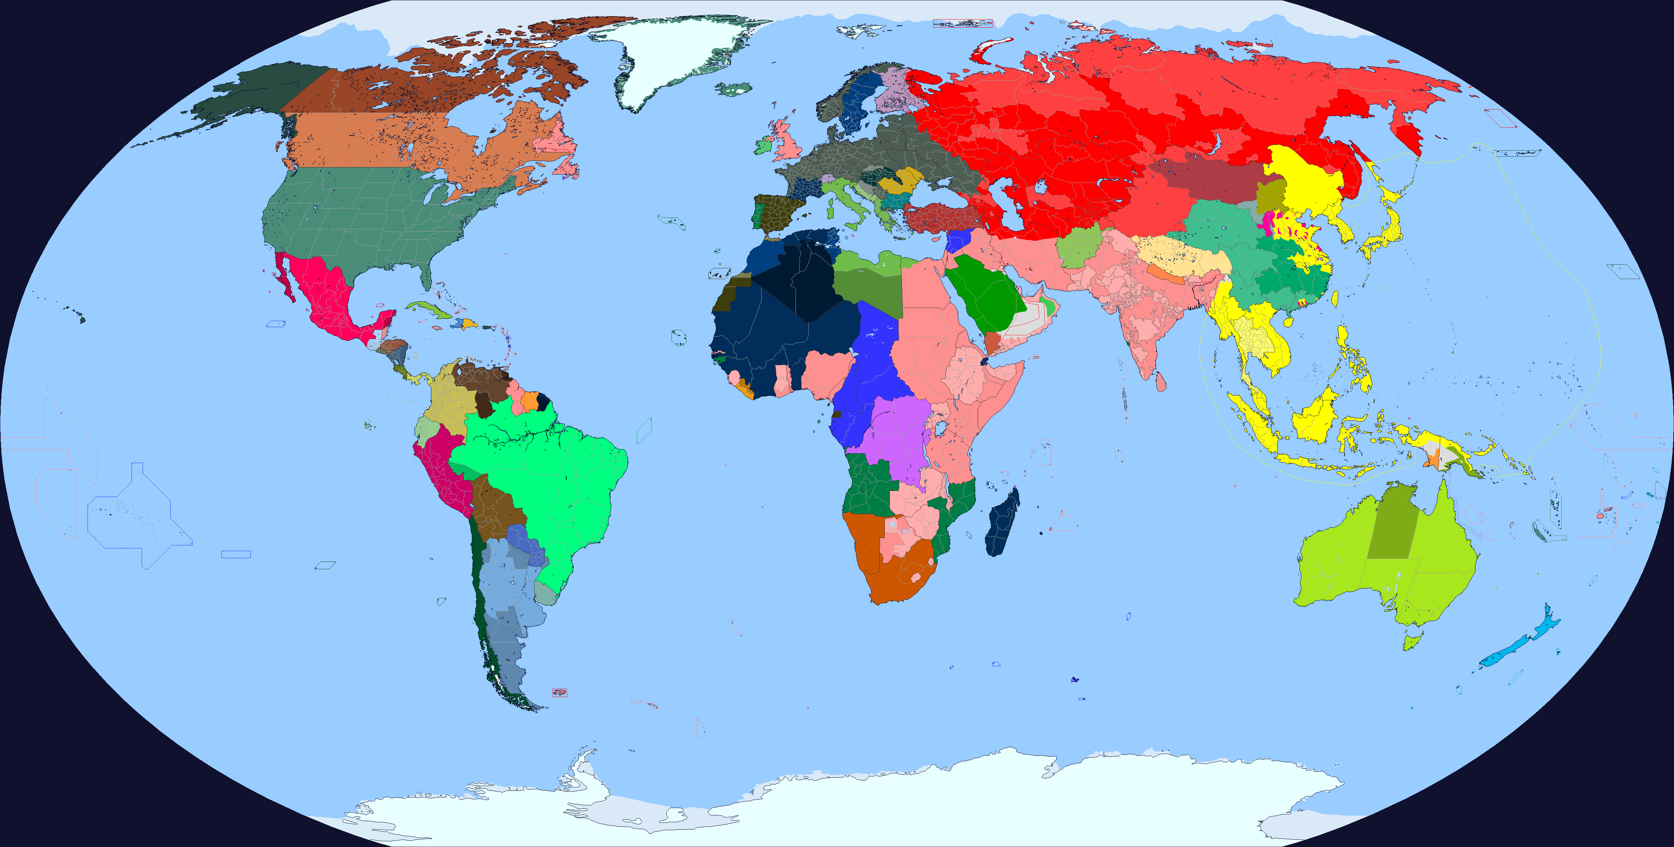
I can’t make the world peaceful

Slide 3
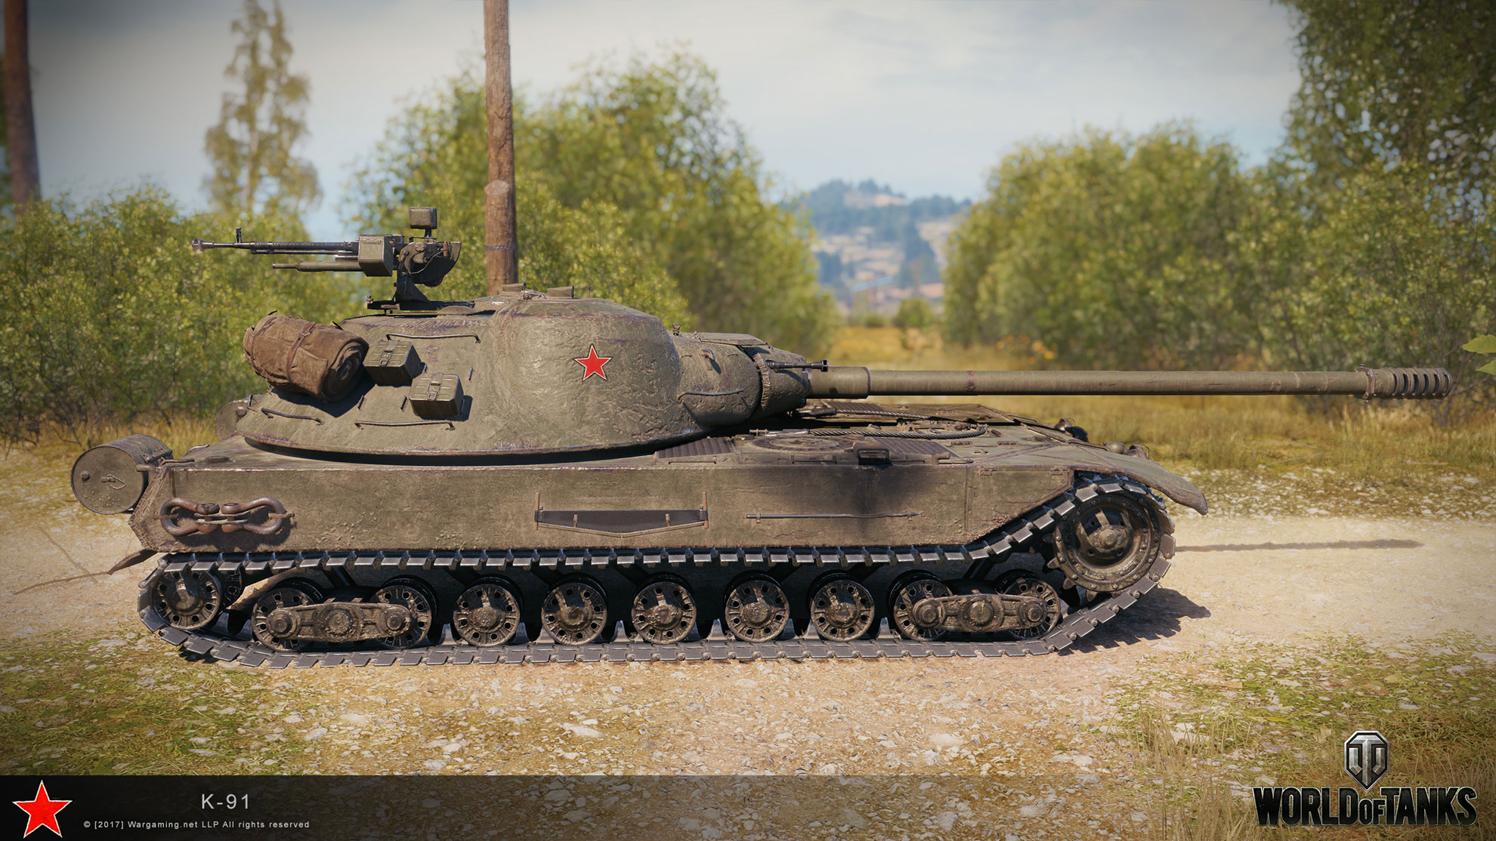
I can’t stall tanks from roaring down roads

Slide 4
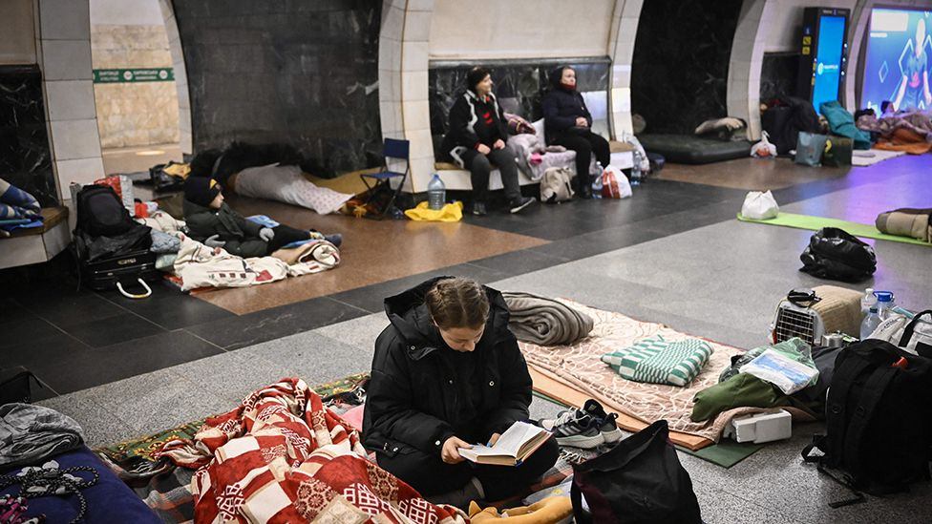
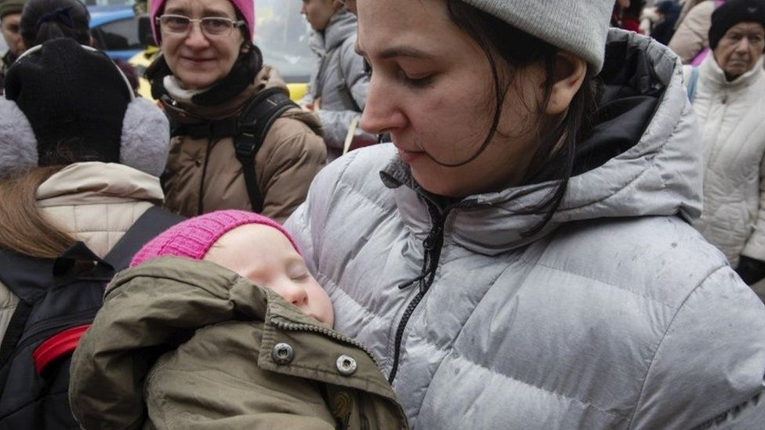
I can’t prevent children from having to hide in bunkers

Slide 5
I can’t convince the news to stop turning war into a video game

Slide 6
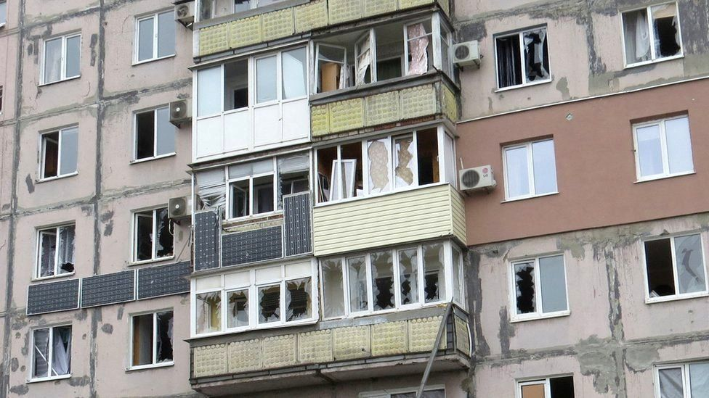
I can’t silence the sound of bombs tearing neighbourhoods apart

Slide 7
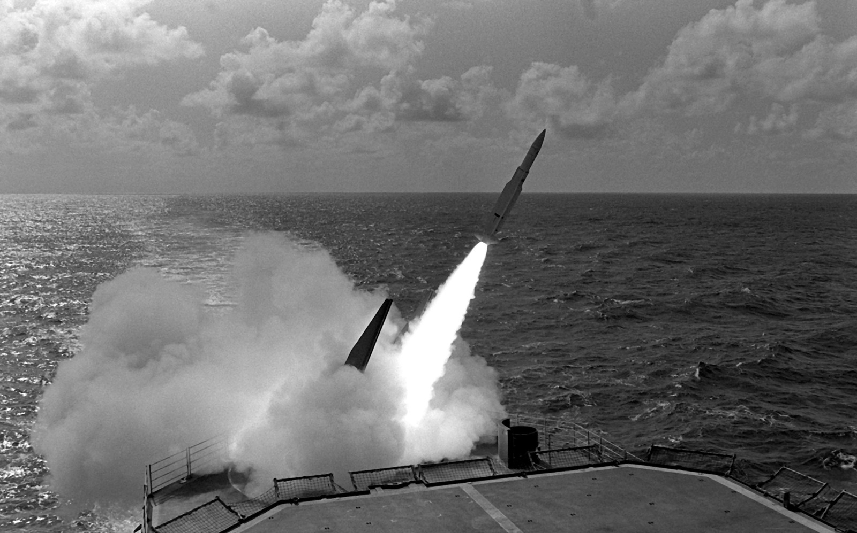
I can’t turn a guided missile into a bouquet of flowers

Slide 8
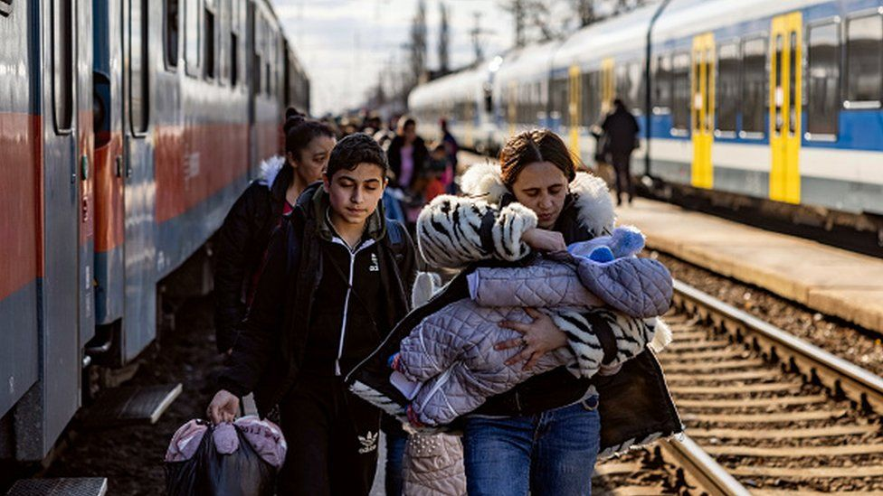
I can’t make a warmonger have an ounce of empathy

Slide 9
I can’t convince ambassadors to quit playing truth or dare

Slide 10
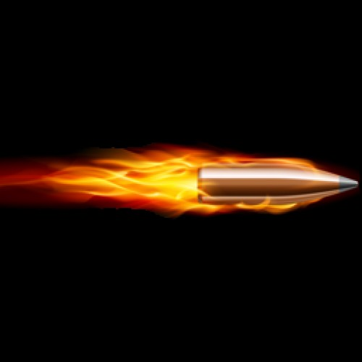
I can’t deflect a sniper’s bullet from turning a wife into a widow

Slide 11
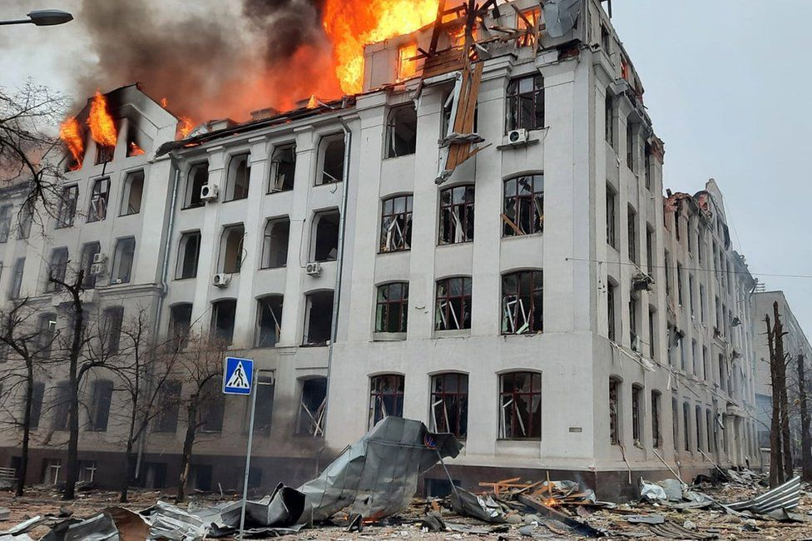
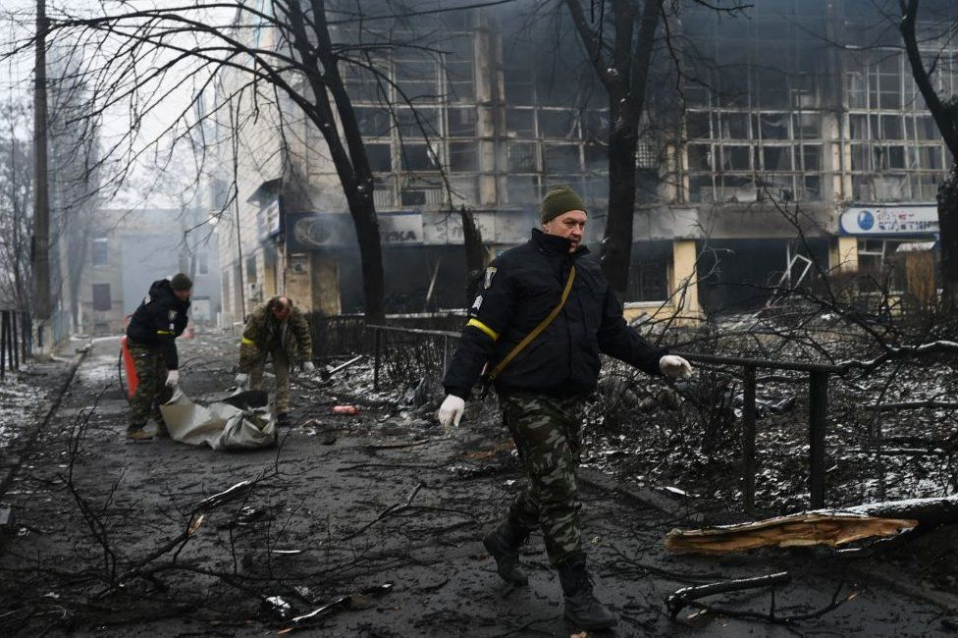
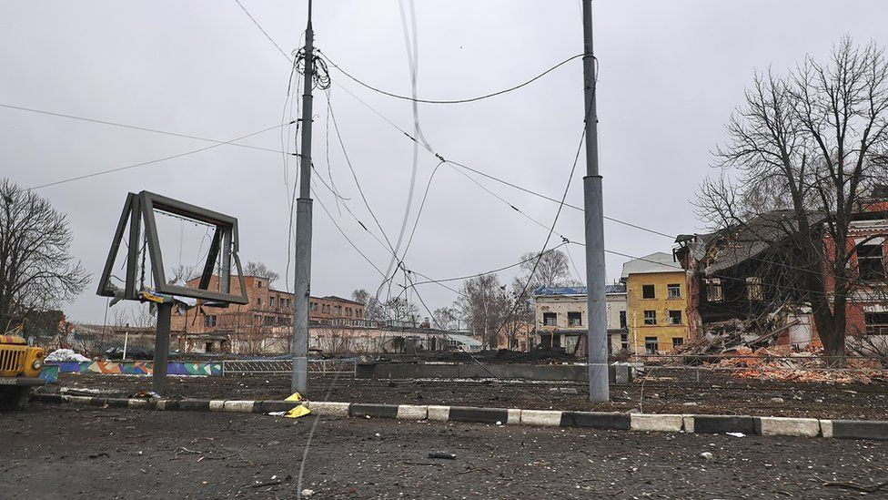
I can’t stave off a country being reduced to ash and rubble

Slide 12
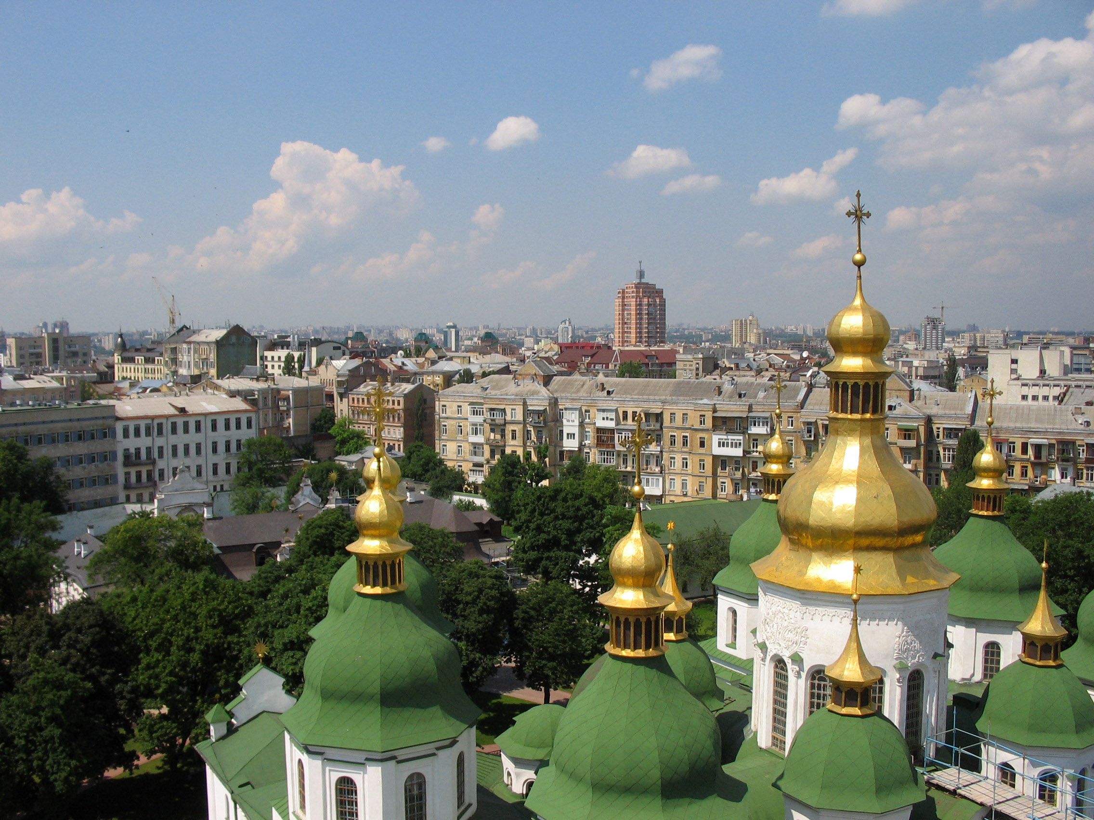
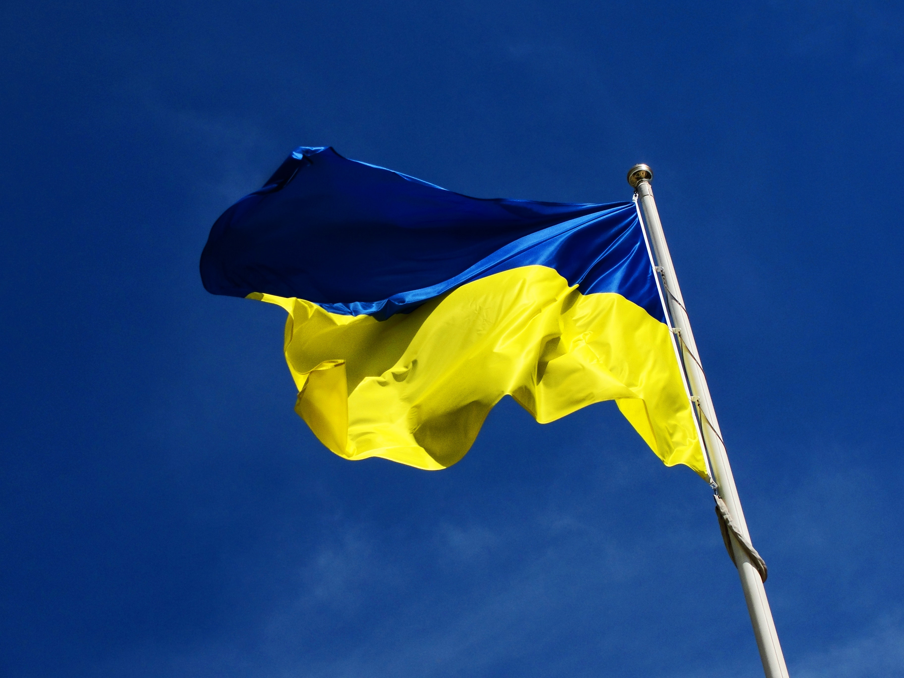
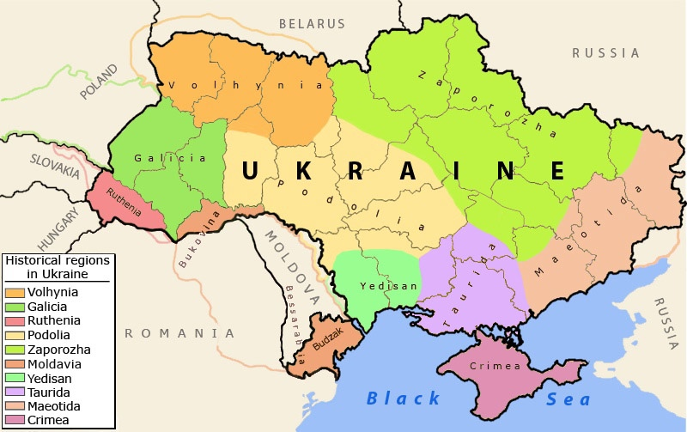
This Photo by Unknown Author is licensed under CC BY-NC
I can’t do any of that

Slide 13
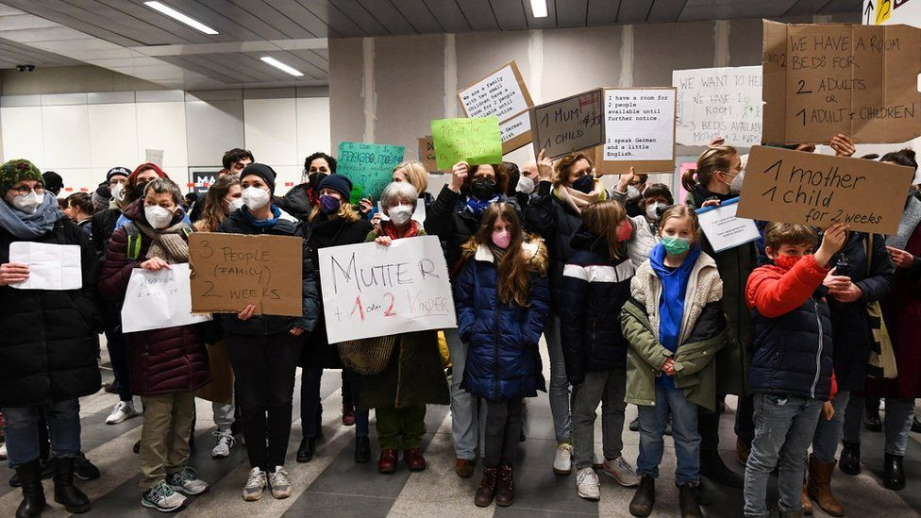
The only thing I can do is love the next person I encounter without any conditions or strings

Slide 14
to love my neighbour so fearlessly that it starts a ripple that stretches from one horizon to the next

Slide 15
I can’t force peace on the world but I can become a force of peace in the world

Slide 16
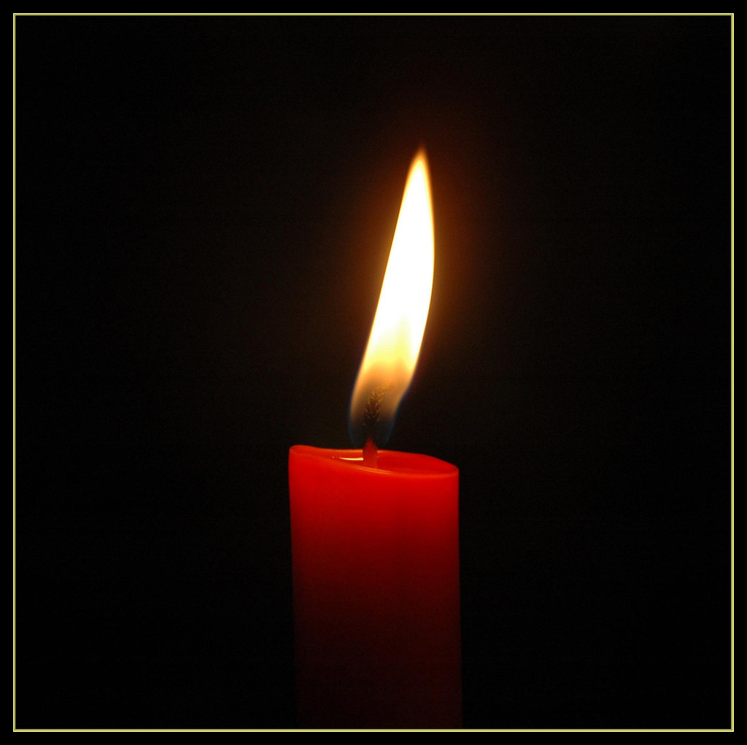
because sometimes all it takes is a single lit candle in the darkness to start a movement
This Photo by Unknown Author is licensed under CC BY-NC-ND

Slide 17
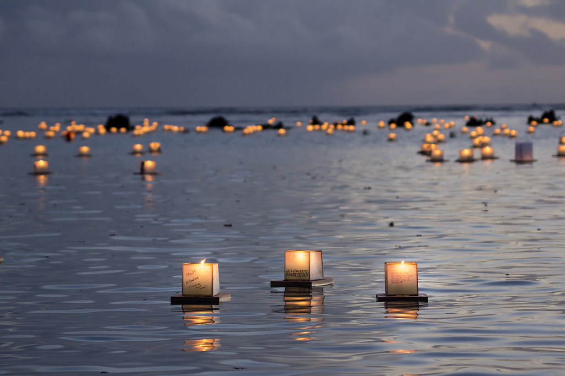
“Lord, make me a candle of comfort in this world let me burn with peace”

